Slide 1
IT Infrastructure Administration
Day 2 & 3: Linux Server Administration
Ephrem Teshale(PhD)
Tadios Abebe
July 22/23, 2025

Slide 2
Linux Server Administration
Windows Server History
About Windows Servers
Windows Server Editions
Installing Windows Server
Customizing Windows Server
Understanding Windows Licensing
Windows Activation Methods
Managing Windows Server
Display and Modify System Properties
Configuring Remote Desktop
Configuring Date and Time
Optimizing UAC
Windows Networking
Managing Devices
Microsoft Management Console
Computer Management Console
Server Management Console
Install Program, Roles and Features
Managing Services
Registry
Disk Management
Active Directory
Installing Active Directory
Configuring Active Directory
Group Policies
Windows Firewall
Knowledge Check
Exercise
Day 1 & 2
Training Outline

Slide 3
The Evolution of Linux: A Historical Journey
1969: UNIX Emerges
1
Developed by Ken Thompson and Dennis Ritchie at Bell Labs, UNIX laid the foundational concepts for modern operating systems, including its modular design and command-line interface.
2
1983: The GNU Project
Richard Stallman initiated the GNU Project with the goal of creating a free and open-source UNIX-like operating system. This project fostered many essential tools and utilities that are integral to Linux today.
1991: Linux Kernel Birth
3
Linus Torvalds, a Finnish student, began developing the Linux kernel, inspired by Minix. He released the source code under the GNU General Public License, leading to its widespread adoption and collaborative development.
4
Present: Global Impact
Linux has grown into a dominant force in server environments, embedded systems, and supercomputing, powering a vast array of technologies worldwide due to its stability, security, and flexibility.

Slide 4

What is Linux
The term Linux is actually quite a misnomer, since it actually refers to the Linux kernel.
However, many distributions use the Linux kernel so therefore are commonly known as Linux operating systems.
A Linux system is divided into three main parts:
Hardware - This includes all the hardware that your system runs on as well as memory, CPU, disks, etc.
Linux Kernel - As we discussed above, the kernel is the core of the operating system. It manages the hardware and tells it how to interact with the system.
User Space - This is where users like yourself will be directly interacting with the system.
There are many Linux distributions to choose from, we’ll just go over the most popular options.

Slide 5
Linux Distributions
Distribution | Base | Package Manager | Use Case | Best For | Notable Features
Ubuntu | Debian | APT (.deb) | General-purpose computing, cloud, servers. | Beginners, system administrators. | LTS releases; strong community support; user-friendly.
Linux Mint | Ubuntu/Debian | APT (.deb) | Desktop operating system. | New Linux users, multimedia/home users. | Out-of-the-box media support; Cinnamon desktop.
Debian | Independent | APT (.deb) | Base for other distros, server workloads. | Experienced users, minimal setups. | Stability; huge repository; multi-arch.
Fedora | Independent (RHEL upstream) | DNF (.rpm) | Developer platforms, testing new tech. | Developers, security-conscious setups. | Advanced packages; SELinux; upstream to RHEL.
Arch Linux | Independent | pacman | Custom, rolling-release systems. | Advanced users who prefer manual control. | User-controlled setup; excellent documentation.
Rocky Linux | RHEL | DNF (.rpm) | Enterprise servers, CentOS replacement. | Organizations needing long-term stability. | RHEL-compatible; actively maintained; community-driven.
Alpine Linux | Independent | apk | Container-based and minimalist environments. | Advanced users, Docker users, embedded systems. | Extremely lightweight, security-focused, musl libc.
AlmaLinux | RHEL | DNF (.rpm) | Server deployments, enterprise workloads. | Cloud/server admins replacing CentOS. | RHEL-compatible; free and open-source; stable releases.
openSUSE Leap | SUSE Linux Enterprise | zypper | Enterprise desktops and servers. | Sysadmins, developers in stable environments. | YaST management tool; tested against SLE.
openSUSE Tumbleweed | Independent | zypper | Rolling-release development environments. | Power users who want the latest software. | Always up-to-date; suitable for dev/testing.

Slide 6
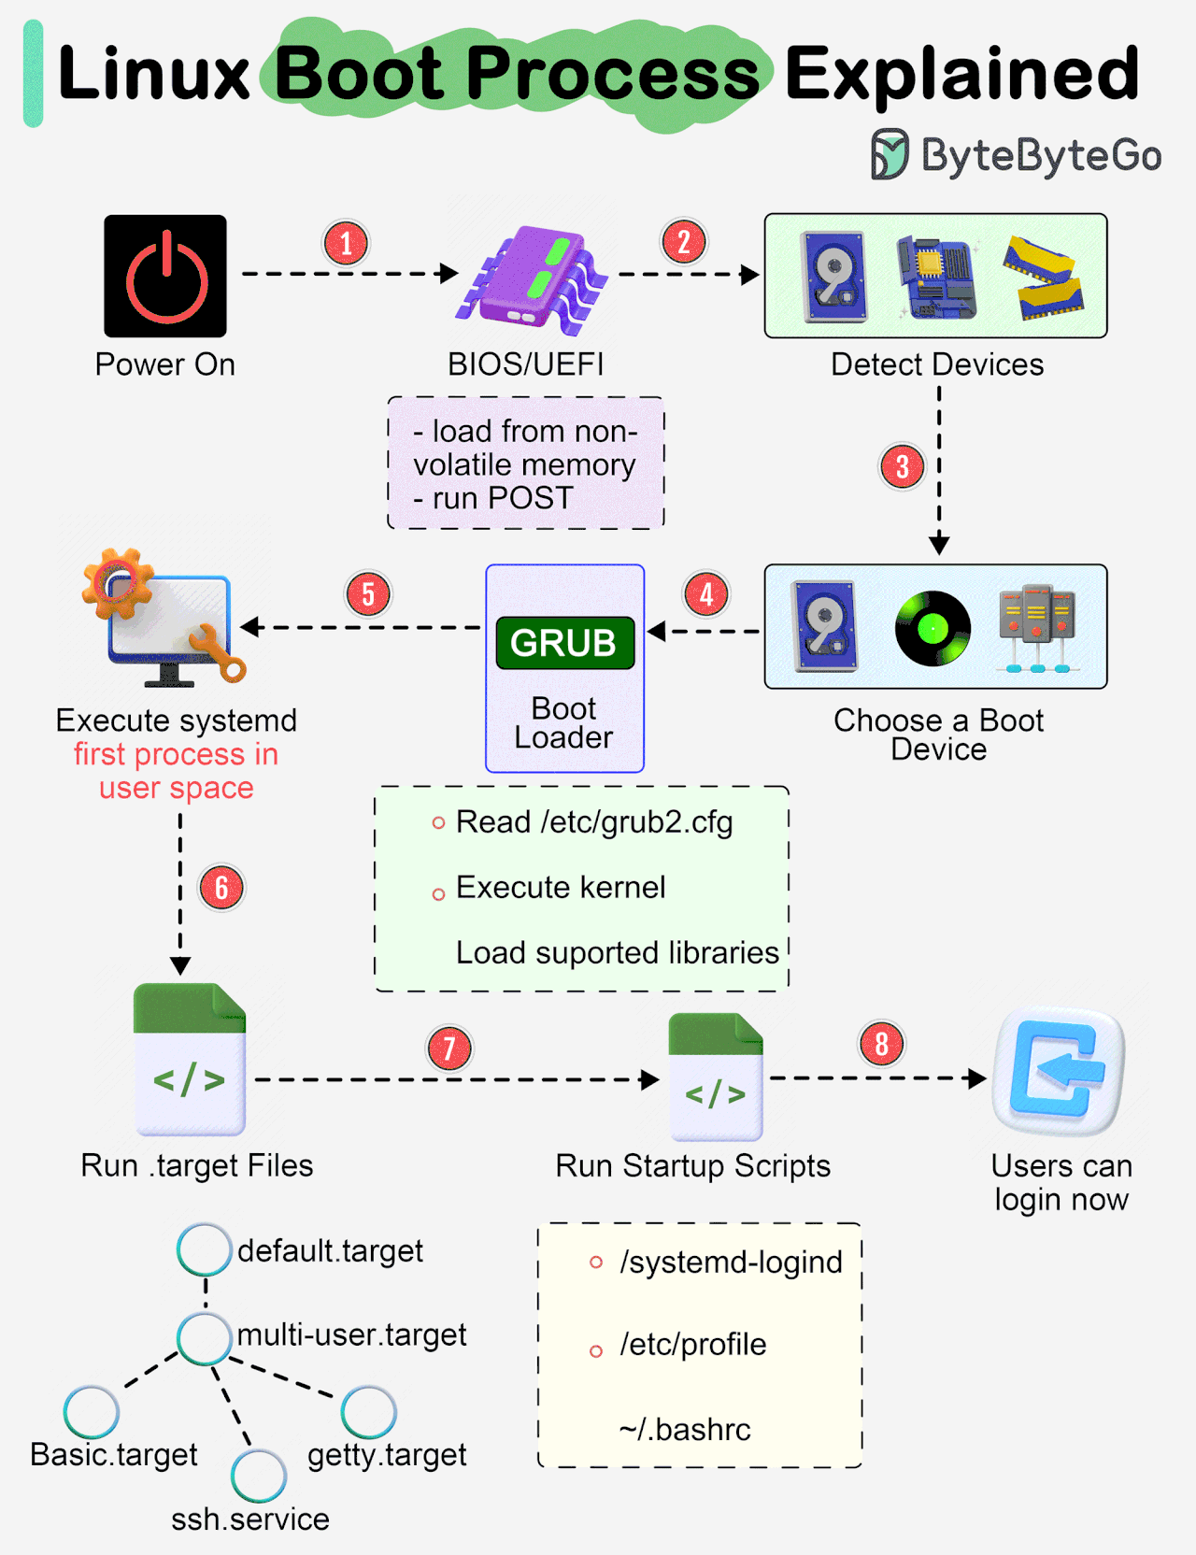
Linux Boot Process
When you turn on your machine, it does some neat things like show you the logo screen, run through some different messages and then at the end you're prompted with a login window.
The Linux boot process can be broken down in 4 simple stages:
BIOS: The BIOS (stands for "Basic Input/Output System") initializes the hardware and makes sure with a Power-on self test (POST) that all the hardware is good to go. The main job of the BIOS is to load up the bootloader.
Bootloader: The bootloader loads the kernel into memory and then starts the kernel with a set of kernel parameters. One of the most common bootloaders is GRUB, which is a universal Linux standard.
Kernel: When the kernel is loaded, it immediately initializes devices and memory. The main job of the kernel is to load up the init process.
Init: Remember the init process is the first process that gets started, init starts and stops essential service process on the system.

Slide 7
The Linux Kernel
Linux system is divided into three main parts: Hardware, Linux Kernel, User Space
Why do we have different abstraction layers for user space and kernel? Why can't you combine both powers into one layer?
In kernel mode, the kernel has complete access to the hardware, it controls everything. In user space mode, there is a very small amount of safe memory and CPU that you are allowed to access.
Basically, when we want to do anything that involves hardware, reading data from our disks, writing data to our disks, controlling our network, etc, it is all done in kernel mode.
Why is this necessary? Imagine if your machine was infected with spyware, you wouldn't want it to be able to have direct access to your system's hardware. It can access all your data, your webcam, etc. and that's no good.

Slide 8
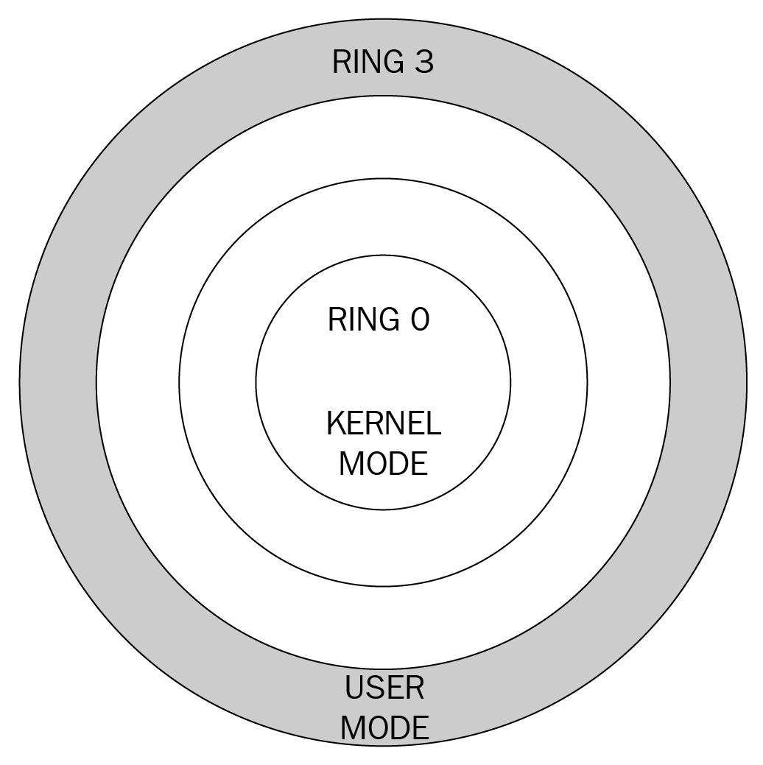
The Linux Kernel - Privilege Levels
These different modes are called privilege levels and are often described as protection rings.
To make this picture easier to paint, let's say you find out that a celebrity is in town at your local club, they are protected by their assistants, then their personal bodyguards, then the bouncer outside the club. You want to get their autograph (because why not?), but you can't get to them because they are heavily protected.
He rings work the same way, the innermost ring corresponds to the highest privilege level.
There are two main levels or modes in an x86 computer architecture.
Ring #3 is the privilege that user mode applications run in, Ring #0 is the privilege that the kernel runs in.
Ring #0 can execute any system instruction and is given full trust.

Slide 9
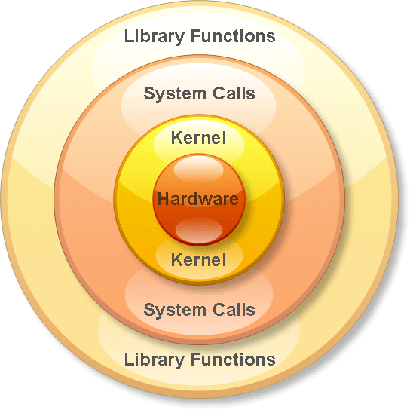
The Linux Kernel - System Calls
So now that we know how those privilege levels work, how are we able to write anything to our hardware? Won't we always be in a different mode than the kernel?
The answer is with system calls, system calls allow us to perform a privileged instruction in kernel mode and then switch back to user mode.
Remember the celebrity in the previous lesson? Let's say we want to see her/him and get some drinks together, how do we get from standing outside in the crowds of people to inside her innermost circle? We would use system calls. System calls are like the VIP passes that get you to a secret side door that leads directly to celebrity.
System calls (syscall) provide user space processes a way to request the kernel to do something for us. The kernel makes certain services available through the system call API. These services allow us to read or write to a file, modify memory usage, modify our network, etc.

Slide 10
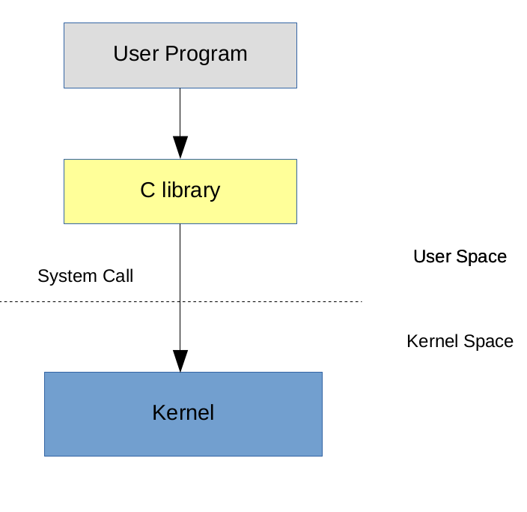
The Linux Kernel
The basics is that when you call a program like ls, the code inside this program contains a system call wrapper (so not the actual system call yet). Inside this wrapper it invokes the system call which will execute a trap, this trap then gets caught by the system call handler and then references the system call in the system call table. Let's say we are trying to call the stat() system call, it's identified by a syscall ID and the purpose of the stat() system call is to query the status of a file. Now remember, you were running the ls program in non-privilege mode. So now it sees you're trying to make a syscall, it then switches you over to kernel mode, there it does lots of things but most importantly it looks up your syscall number, finds it in a table based on the syscall ID and then executes the function you wanted to run. Once it's done, it will return back to user mode and your process will receive a return status if it was successful or if it had an error.

Slide 11
Kernel Location
What happens when you install a new kernel? Well it actually adds a couple of files to your system, these files are usually added to the /boot directory. You will see multiple files for different kernel versions:
vmlinuz - this is the actual linux kernel
initrd - as we've discussed before, the initrd is used as a temporary file system, used before loading the kernel
System.map - symbolic lookup table
config - kernel configuration settings, if you are compiling your own kernel, you can set which modules can be loaded
If your /boot directory runs out of space, you can always delete old versions of these files or just use a package manager, but be careful when doing maintenance in this directory and don't accidentally delete the kernel you are using.

Slide 12
Kernel Modules
The kernel in itself is a monolithic piece of software, when we want to add support for a new type of keyboard, we don't write this code directly into the kernel code.
Kernel modules are pieces of code that can be loaded and unloaded into the kernel on demand. They allow us to extend the functionality of the kernel without actually adding to the core kernel code.
View a list of currently loaded modules
lsmod
Load a module
sudo modprobe bluetooth
Remove a module
sudo modprobe -r bluetooth
You can also load modules during system boot, instead of temporarily loading them with modprobe (which will be unloaded when you reboot). Just modify the /etc/modprobe.d directory and add a configuration file in it.

Slide 13
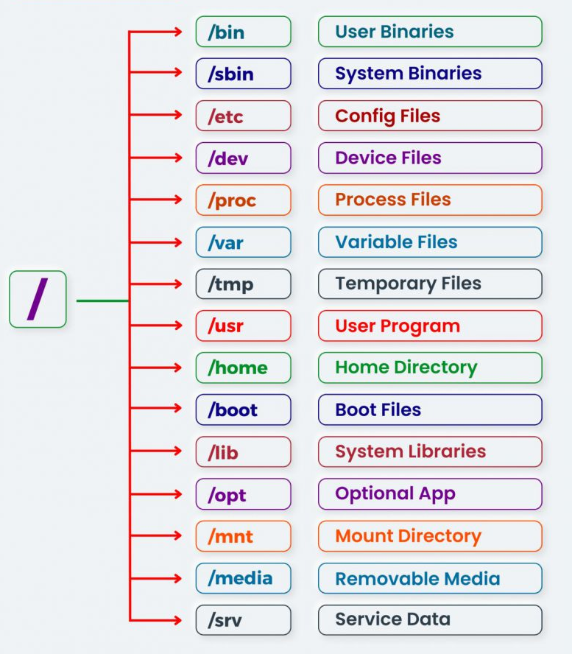
The Linux Filesystem
/ - The root directory of the entire filesystem hierarchy, everything is nestled under this directory.
/bin - Essential ready-to-run programs (binaries), includes the most basic commands such as ls and cp.
/sbin - Contains essential system binaries, usually can only be ran by root.
/etc - Core system configuration directory, should hold only configuration files and not any binaries.
/dev - Device files.
/proc - Information about currently running processes.
/var - Variable directory, it's used for system logging, user tracking, caches, etc. Basically anything that is subject to change all the time.
/tmp - Storage for temporary files
/usr - This is unfortunately named, most often it does not contain user files in the sense of a home folder. This is meant for user installed software and utilities, however that is not to say you can't add personal directories in there. Inside this directory are sub-directories for /usr/bin, /usr/local, etc.
/home - Personal directories for users, holds your documents, files, settings, etc.
/boot - Contains kernel boot loader files.
/lib - Holds library files that binaries can use.
/opt - Optional application software packages.
/mnt - Temporarily mounted filesystems.
/media - Used as an attachment point for removable media like USB drives.
/srv - Site-specific data which are served by the system.
/root - The root user's home directory.
/run - Information about the running system since the last boot.

Slide 14
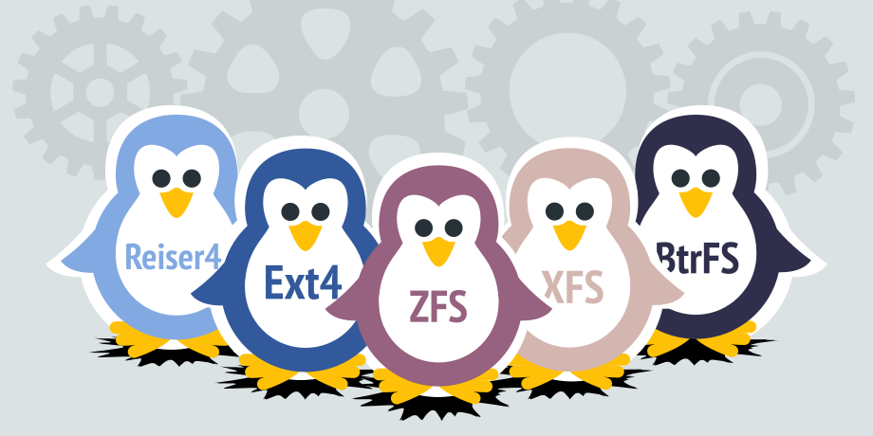
Filesystem Types
ext4 - This is the most current version of the native Linux filesystems. It is compatible with the older ext2 and ext3 versions. It supports disk volumes up to 1 exabyte and file sizes up to 16 terabytes and much more. It is the standard choice for Linux filesystems.
Btrfs - "Better or Butter FS" it is a new filesystem for Linux that comes with snapshots, incremental backups, performance increase and much more. It is widely available, but not quite stable and compatible yet.
XFS - High performance journaling file system, great for a system with large files such as a media server.
NTFS and FAT - Windows file systems
HFS+ - Macintosh filesystem
Check out what filesystems are on your machine:
df -T
lsblk -f

Slide 15

Disk Anatomy
Disks are comprised of partitions that help us organize our data. You can have multiple partitions on a disk and they can't overlap each other. If there is space that is not allocated to a partition, then it is known as free space. The types of partitions depend on your partition table. Inside a partition, you can have a filesystem or dedicate a partition to other things like swap

Slide 16
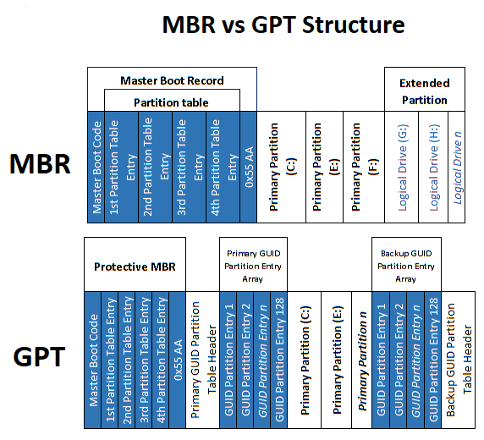
Disk Anatomy
MBR
Traditional partition table, was used as the standard
Can have primary, extended, and logical partitions
MBR has a limit of four primary partitions
Additional partitions can be made by making a primary partition into an extended partition (there can only be one extended partition on a disk). Then inside the extended partition you add logical partitions. The logical partitions are used just like any other partition. Silly I know.
Supports disks up to 2 terabytes
GPT
GUID Partition Table (GPT) is becoming the new standard for disk partitioning
Has only one type of partition and you can make many of them
Each partition has a globally unique ID (GUID)
Used mostly in conjunction with UEFI based booting (we'll get into details in another course)

Slide 17
Disk Anatomy
You can use the fdisk of cfdisk utility to partition and manage your disks
cfdisk /dev/sda
You can create a filesystem using the mkfs utility
sudo mkfs -t ext4 /dev/sdb2
First create the mount point and mount a partition to that directory
mkdir /mydrive
sudo mount -t ext4 /dev/sdb2 /mydrive
Kernel names devices in the order it finds them. What if our device name changes for some reason after we mount it? Well fortunately, you can use a device's universally unique ID (UUID) instead of a name.
sudo blkid
And you can mount using the uuid
sudo mount UUID=130b882f-7d79-436d-a096-1e594c92bb76 /mydrive

Slide 18
Disk Anatomy - mounts
When we want to automatically mount file systems at startup we can add them to a file called /etc/fstab
pete@icebox:~$ cat /etc/fstab
UUID=130b882f-7d79-436d-a096-1e594c92bb76 / ext4 relatime,errors=remount-ro 0 1
UUID=78d203a0-7c18-49bd-9e07-54f44cdb5726 /home xfs relatime 0 2
UUID=22c3d34b-467e-467c-b44d-f03803c2c526 none swap sw 0 0
UUID - Device identifier
Mount point - Directory the filesystem is mounted to
Filesystem type
Options - other mount options, see man page for more details
Dump - used by the dump utility to decide when to make a backup, you should just default to 0
Pass - Used by fsck to decide what order file systems should be checked, if the value is 0, it will not be checked

Slide 19
Disk Anatomy
The disk usage of a file system can be retrieved using
df -h
The fsck (filesystem check) command is used to check the consistency of a filesystem and can even try to repair it for us. Usually when you boot up a disk, fsck will run before your disk is mounted to make sure everything is ok.
The fsck (filesystem check) command is used to check the consistency of a filesystem and can even try to repair it for us. Usually when you boot up a disk, fsck will run before your disk is mounted to make sure everything is ok.
sudo fsck /dev/sda

Slide 20
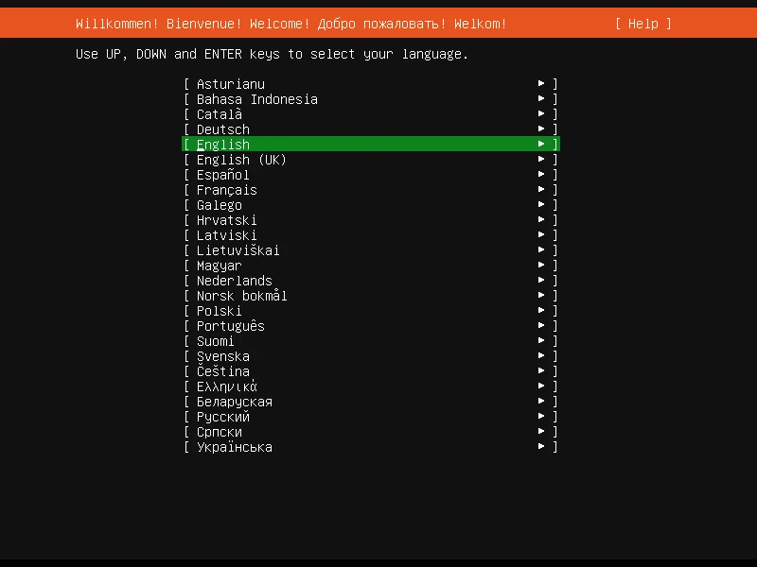
Installing a Linux Server
Step 1: Download Ubuntu Server
Step 2: Create a Virtual Machine
Step 3: Launch the Installer
Step 4: Configure Network
Step 5: Configure Storage
Step 6: Create User Account
Step 7: Configure Optional Features
Step 8: Finish Installation
Step 9: Post-Installation Check

Slide 21
Configuring Linux Server
System Update
After installing a new Linux server, ensure that security patches and system improvements are applied promptly. This reduces the probability of system vulnerabilities being exploited.
sudo apt update && sudo apt upgrade -y
Distribution | Update Package List | Upgrade Packages | Remove Unused Packages
Ubuntu/Debian | sudo apt update | sudo apt upgrade -y | sudo apt autoremove -y && sudo apt clean
RHEL/Rocky | sudo dnf check-update | sudo dnf upgrade -y | sudo dnf autoremove -y
Fedora | sudo dnf check-update | sudo dnf upgrade -y | sudo dnf autoremove -y
Arch Linux | sudo pacman -Sy | sudo pacman -Su | sudo pacman -Rns $(pacman -Qdtq)
openSUSE | sudo zypper refresh | sudo zypper update -y | sudo zypper packages --orphaned
Alpine Linux | sudo apk update | sudo apk upgrade | sudo apk cache clean

Slide 22
Configuring Linux Server
Configure Networking
In Linux, network settings are managed through configuration files. The location and format of these files differ between distributions:
Distribution | Base | Package Manager | Use Case | Best For | Notable Features
Ubuntu | Debian | APT (.deb) | General-purpose computing, cloud, servers. | Beginners, system administrators. | LTS releases; strong community support; user-friendly.
Linux Mint | Ubuntu/Debian | APT (.deb) | Desktop operating system. | New Linux users, multimedia/home users. | Out-of-the-box media support; Cinnamon desktop.
Debian | Independent | APT (.deb) | Base for other distros, server workloads. | Experienced users, minimal setups. | Stability; huge repository; multi-arch.
Fedora | Independent (RHEL upstream) | DNF (.rpm) | Developer platforms, testing new tech. | Developers, security-conscious setups. | Advanced packages; SELinux; upstream to RHEL.
Arch Linux | Independent | pacman | Custom, rolling-release systems. | Advanced users who prefer manual control. | User-controlled setup; excellent documentation.
Rocky Linux | RHEL | DNF (.rpm) | Enterprise servers, CentOS replacement. | Organizations needing long-term stability. | RHEL-compatible; actively maintained; community-driven.
Alpine Linux | Independent | apk | Container-based and minimalist environments. | Advanced users, Docker users, embedded systems. | Extremely lightweight, security-focused, musl libc.
AlmaLinux | RHEL | DNF (.rpm) | Server deployments, enterprise workloads. | Cloud/server admins replacing CentOS. | RHEL-compatible; free and open-source; stable releases.
openSUSE Leap | SUSE Linux Enterprise | zypper | Enterprise desktops and servers. | Sysadmins, developers in stable environments. | YaST management tool; tested against SLE.
openSUSE Tumbleweed | Independent | zypper | Rolling-release development environments. | Power users who want the latest software. | Always up-to-date; suitable for dev/testing.

Slide 23
Configure Networking - netplan and ifconfig
netplan
sudo nano /etc/netplan/00-installer-config.yaml
In Linux, network settings are managed through configuration files. The location and format of these files differ between distributions:
network:
version: 2
ethernets:
enp0s3:
dhcp4: no
addresses: [192.168.1.50/24]
gateway4: 192.168.1.1
nameservers:
addresses: [8.8.8.8, 1.1.1.1]
sudo netplan apply
ifconfig
Another tool to configure networking in linux is ifconfig
To create an interface and bring it up
ifconfig eth0 192.168.2.1 netmask 255.255.255.0 up
This assigns an IP address and netmask to the eth0 interface and also turns it up.
To bring up or down an interface
ifup eth0
ifdown eth0

Slide 24
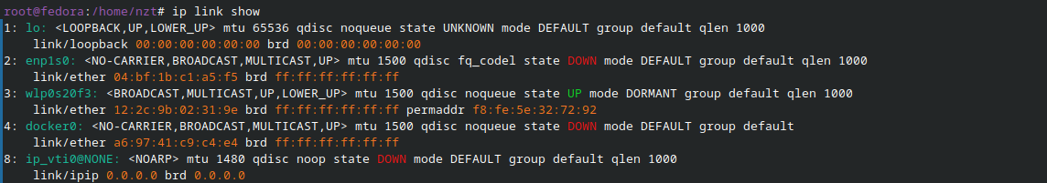
Configure Networking - ip
ip
The ip command also allows us to manipulate the networking stack of a system. Depending on the distribution you are using it may be the preferred method of manipulating your network settings.
To show interface information for all interfaces
ip link show
To show the statistics of an interface
ip -s link show eth0
To show ip addresses allocated to interfaces
ip address show
To bring interfaces up and down
ip link set eth0 up
ip link set eth0 down
To add an IP address to an interface
ip address add 192.168.1.1/24 dev eth0

Slide 25
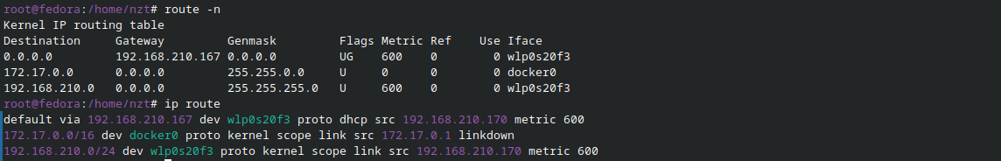
Configure Networking - route
route
To view the routing table of a linux system
ip route
route -n
Add a new route
ip route add 192.168.2.1/23 via 10.11.12.3
sudo route add -net 192.168.2.1/23 gw 10.11.12.3
Delete a route
ip route delete 192.168.2.1/23 via 10.11.12.3
or
sudo route del -net 192.168.2.1/23
Obtain a fresh ip
sudo dhclient

Slide 26
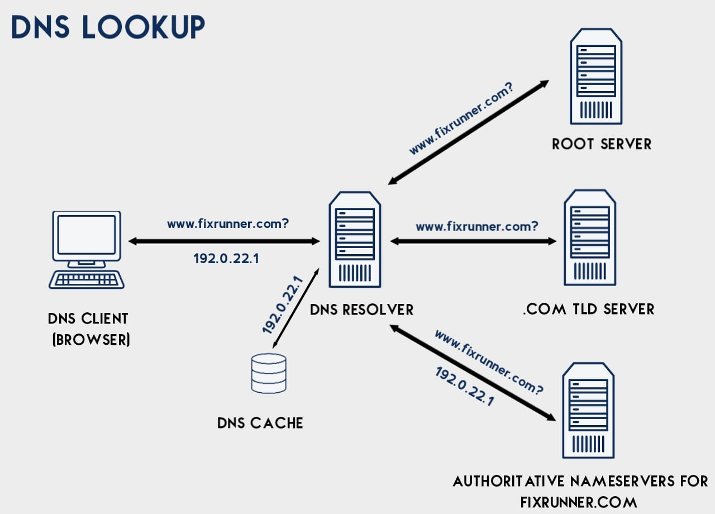
Configure Networking - DNS
DNS Process
First our host asks, "Where is zergaw.com?", our local DNS server doesn't know so it goes and starts from the top of the funnel to ask the Root Servers. Keep in mind that our host is not making these requests to find zergaw.com directly, most users talk to a recursive DNS server provided by their ISPs and that server is then tasked to find the location of zergaw.com.
There are 13 Root Servers for the Internet, they are mirrored and distributed around the world to handle DNS requests for the Internet, so there are really hundreds of servers that are working, they are controlled by different organizations and they contain information about Top-Level Domains. Top-level domains are what you know as .org, .com, .net, etc addresses. So the Root Server doesn't know where zergaw.com is, so it tells us ask the .com Top-Level Domain DNS Server at an IP address it gives us.
So now we send another request to the name server that knows about ".com" addresses and asks if it knows where zergaw.com is? The TLD doesn't have the zergaw.com in their zone files, but it does see a record for the name server for zergaw.com. So it gives us the IP address of that name server and tells us to look there.
Now we send a final request to the DNS server that actually has the record we want. The name server sees that it has a zone file for zergaw.com and there is a resource record for 'www' for this host. It then gives us the IP address of this host and we can finally see some cats on the Internet.

Slide 27
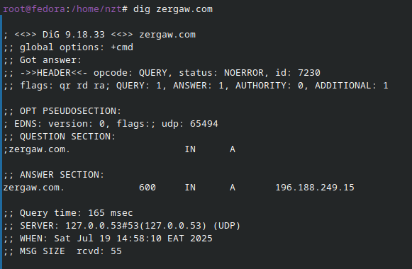
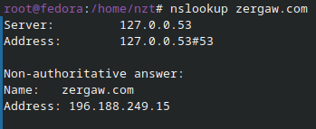
Configure Networking - DNS
DNS
Before our machine actually hits DNS to do a query, it first looks locally on our machines.
The /etc/hosts file contains mappings of some hostnames to IP addresses. The fields are pretty self explanatory, there is one for the IP address, the hostname and then any alias's for the host.
The "name server lookup" tool is used to query name servers to find information about resource records.
Dig (domain information groper) is a powerful tool for getting information about DNS name servers, it is more flexible than nslookup and great for troubleshooting DNS issues.

Slide 28
Core Linux Commands
Command | Description
ls | List files and directories in the current location.
cd | Change the current directory.
pwd | Print the current working directory.
cp | Copy files or directories.
mv | Move or rename a file or directory.
rm | Delete files or directories.
mkdir | Create a new directory.
touch | Create an empty file or update the timestamp.
cat | Display the content of a file.
less | View the file content one screen at a time.
head | Show the first few lines of a file.
tail | Show the last few lines of a file.
echo | Print text or variables to the terminal.
grep | Search for patterns in text.

Slide 29
Core Linux Commands
Command | Description
find | Search for files and directories recursively.
chmod | Change file or directory permissions.
chown | Change file or directory ownership.
df | Show disk space usage.
du | Show file/directory size.
top | Real-time view of system processes and resource usage.
htop | Enhanced version of top with a user-friendly interface
ps | List running processes.
kill | Send a signal to a process (often to terminate it).
sudo | Run a command with superuser (admin) privileges.
apt | Manage packages on Debian-based systems.
dnf | Manage packages on RHEL/Fedora systems.
wget | Download files from the internet.
curl | Transfer data to/from URLs (supports multiple protocols).
man | Display the manual for a command.
history | Show previously run commands.

Slide 30
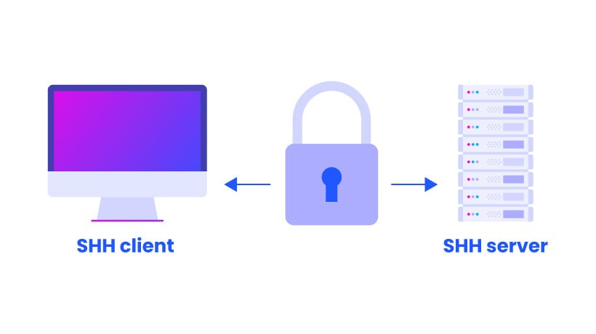
Configuring SSH
Enter the following command to install the OpenSSH service:
sudo apt install openssh-server -y
Default SSH settings may leave a server vulnerable to brute-force attacks or scanning bots. To improve security, users can customize SSH settings in the /etc/ssh/sshd_config file, including:
Changing the default port number.
Disabling remote root access to the server.
Enabling key-based SSH authentication. (Optional)
Restricting access to specific IP addresses or users.

Slide 31
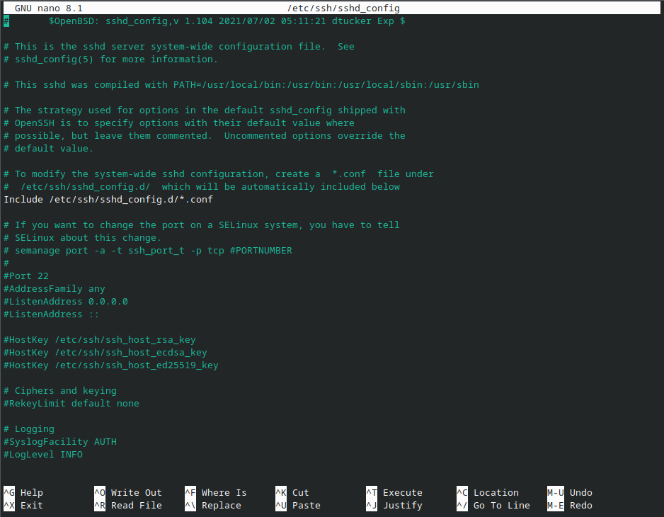
Configuring SSH
Use a preferred text editor, such as Nano, to access the SSH config file:
sudo nano /etc/ssh/sshd_config
Important setting to change
Port
PermitRootLogin
PasswordAuthentication
PermitEmptyPasswords

Slide 32
Configure Firewall
A firewall monitors and controls incoming and outgoing traffic to and from the server. It is designed to protect systems from unauthorized access, particularly from untrusted external networks.
Most Linux distributions support firewall tools built on top of iptables or nftables. The table below lists recommended firewall tools for major Linux distributions, along with commands to install and enable them:
Example ufw commands
sudo ufw allow ssh
sudo ufw allow 2477/tcp
Distribution | Recommended Tool | Install Command | Enable and Start Command
Ubuntu/Debian | ufw (Uncomplicated Firewall) | sudo apt install ufw | sudo ufw enable
RHEL/Rocky | firewalld | sudo dnf install firewalld | sudo systemctl enable --now firewalld
Fedora | firewalld | Preinstalled (usually) | sudo systemctl enable --now firewalld
Arch Linux | iptables or ufw | sudo pacman -S ufw or sudo pacman -S iptables | sudo systemctl enable --now ufw (or iptables)
openSUSE | firewalld | sudo zypper install firewalld | sudo systemctl enable --now firewalld
Alpine Linux | iptables | Built-in (via the iptables package) | Rules applied via /etc/network/interfaces

Slide 33
Linux Permissions
Linux enforces access controls using a permission model built into the file system. Every file and directory has an owner, an associated group, and permissions for three user categories:
User (u). The owner of the file or directory.
Group (g). Other users in the owners group.
Others (o). Everyone else on the system.
Each of these user categories can be granted the following permissions:
Use the ls command to view permissions for a file or directory:
ls -l
Permission | Symbol | Description
Read | r | A user can view file contents or list directory contents.
Write | w | A user with write permissions can create, move, and delete files or directories, as well as modify or remove file contents.
Execute | x | Allows a user to run script/executable files or enter/traverse directories.

Slide 34
Managing User and Permissions
Enter the following command on your Ubuntu Server to create a non-root admin user:
sudo adduser newuser
Follow the prompts to set a password and optional user details.
Next, add the new user to the sudo group:
sudo usermod -aG sudo newuser
This grants the user administrative privileges while keeping root access disabled.
The following table lists the most commonly used commands:
Command | Function
adduser or useradd | Creates a new user.
usermod | Modifies user properties (e.g., add to group).
passwd | Sets or updates the user password.
ls -l | Displays file permissions.
chmod | Changes file permissions.
chown | Changes the file owner and group.

Slide 35
Install and Manage Software Packages
One of the key benefits of a package manager is that you can install multiple tools or even entire software stacks with a single command:
sudo apt update && sudo apt install apache2 mysql-server php libapache2-mod-php php-mysql ufw -y
Each distribution has its default package manager:
Distribution | Package Manager | Example Commands
Ubuntu/Debian | APT | sudo apt install nginx
RHEL/Fedora | DNF | sudo dnf install nginx
Arch Linux | Pacman | sudo pacman -S nginx
openSUSE | Zypper | sudo zypper install nginx
Alpine Linux | apk | sudo apk add nginx

Slide 36
Linux Processes
Processes are the programs that are running on your machine. They are managed by the kernel and each process has an ID associated with it called the process ID (PID).
This PID is assigned in the order that processes are created.
ps aux displays all processes running, including the ones being ran by other users
You can send signals that terminate processes, such a command is aptly named the kill command. By default it sends a TERM signal and with -9 it will run the SIGKILL signal and kill the process.
kill -9 12445
Other signals include
SIGHUP - Hangup, sent to a process when the controlling terminal is closed. For example, if you closed a terminal window that had a process running in it, you would get a SIGHUP signal. So basically you've been hung up on
SIGINT - Is an interrupt signal, so you can use Ctrl-C and the system will try to gracefully kill the process
SIGTERM - Kill the process, but allow it to do some cleanup first
SIGKILL - Kill the process, kill it with fire, doesn't do any cleanup
SIGSTOP - Stop/suspend a process

Slide 37
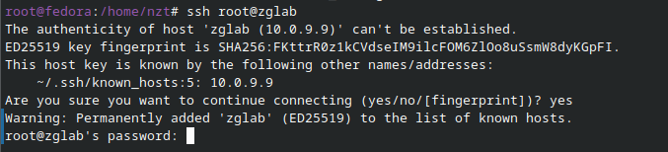
Logging into remote server
After installing and setting up the SSH client and server on both machines:
Establish a secure remote connection using the SSH command:
ssh [username]@[host_ip_address] or
ssh host_ip_address
When connecting to the server for the first time, the following message appears:
The authenticity of host '192.168.1.10' can't be established.
ECDSA key fingerprint is SHA256:...
Are you sure you want to continue connecting (yes/no)?
Type yes and press Enter to trust the server and save its key to your local system.
Provide the password when prompted (characters do not appear as you type) and press Enter.

Slide 38

Transfer Files to/from a Linux Server
Rsync is a free command-line utility for transferring files and directories both locally and between local and remote systems. It is preinstalled on most modern Linux distributions.
Other simple file sharing tool is the scp command. The scp command stands for secure copy, it works exactly the way the cp command does, but allows you to copy from one host over to another host on the same network. It works via ssh so all your actions are using the same authentication and security as ssh.
rsync [OPTION] [SOURCE] [USERNAME]@[HOSTNAME_OR_IP]:[DESTINATION]
rsync [OPTION] [USERNAME]@[HOSTNAME_OR_IP]:[SOURCE] [DESTINATION]
scp myfile.txt username@remotehost.com:/remote/directory
scp username@remotehost.com:/remote/directory/myfile.txt /local/directory
Python has a super useful tool for serving files over HTTP. This is great if you just want to create a quick network share that other machines on your network can access. To do that just go to the directory you want to share and run:
python3 -m http.server

Slide 39
Scheduling Tasks on Linux
The cron utility reads the crontab (cron table) file and executes scheduled commands or scripts at specified times and intervals. A cron job line in a crontab file must follow this format:
MIN HOUR DOM MON DOW CMD
For example, the following line prompts Cron to execute a script on January 1st at 9 AM:
0 9 1 1 * /path/to/your_script.sh
Task | Schedule | Crontab Line
Run a backup script every day at 2 AM | Daily | 0 2 * * * /home/user/scripts/backup.sh
Clear temp files every Sunday night | Weekly | 0 23 * * 0 rm -rf /tmp/*
Run a system update on the 1st of every month | Monthly | 0 4 1 * * apt update && apt upgrade -y
Other important command
crontab -l # To view the current user's scheduled cron jobs, enter
crontab -e # This opens crontab in the system's default text editor, where you can add, remove, or change scheduled tasks.
crontab -r # To remove your crontab and all scheduled jobs, enter

Slide 40
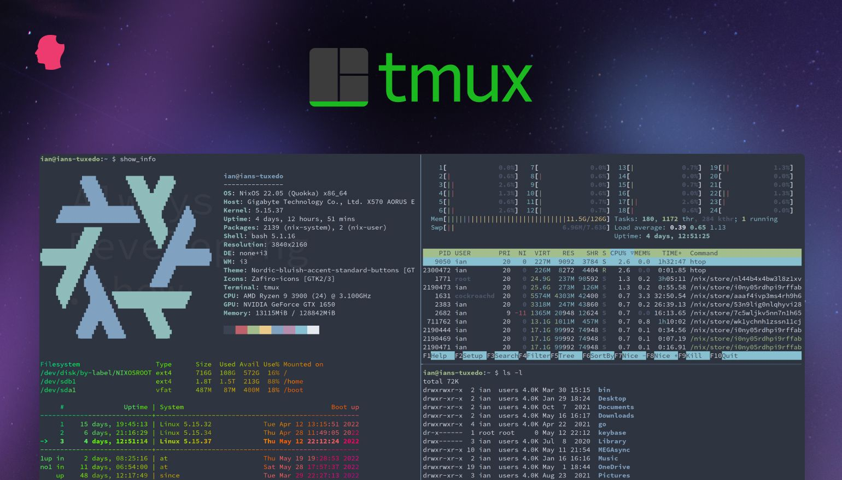
Managing Terminal Sessions in Linux
Administrators often need to manage multiple terminal sessions from a single interface. This is especially useful for server administration, scripting, or working over SSH connections. If the session drops or you need to step away, the tasks keep running in the background.
Terminal multiplexers like Byobu, tmux, and screen allow you to:
Run multiple terminal sessions within a single SSH connection.
Split the terminal into resizable horizontal and vertical panes.
Keep tasks running even if your session disconnects.
Detach and reattach to sessions without losing state.

Slide 41
Managing Terminal Sessions in Linux
Function | Byobu | tmux | screen
Start a session. | byobu | tmux | screen
Detach a session. | Ctrl+A, then D (or byobu detach) | Ctrl+B, then D | Ctrl+A, then D
Reattach a session. | byobu attach | tmux attach | screen -r
Create a new window. | Ctrl+A, then C | Ctrl+B, then C | Ctrl+A, then C
Next window. | Ctrl+A, then N | Ctrl+B, then N | Ctrl+A, then N
Previous window. | Ctrl+A, then P | Ctrl+B, then P | Ctrl+A, then P
Horizontal split. | Ctrl+A, then Shift+S | Ctrl+B, then " (double quote) | No built-in split support
Vertical split. | Ctrl+A, then ` (backtick) | Ctrl+B, then % | Not applicable
Move between panes. | Ctrl+A, then arrow keys | Ctrl+B, then arrow keys | Not applicable
Close the current window/pane. | exit | exit or Ctrl+D | exit or Ctrl+D

Slide 42
Knowledge Check
What does the chmod 755 script.sh command do?
A. Grants read/write to owner, read to group/others
B. Grants full permissions to owner, read/execute to group/others
C. Grants read/write/execute to owner, read/execute to group/others
D. Grants execute-only to all users
What is the purpose of journalctl?
A. Manage disk partitions
B. Query systemd journal logs
C. Configure network interfaces
D. Schedule cron jobs
Which package manager is used in RHEL-based distributions?
A. apt
B. dnf
C. pacman
D. zypper

Slide 43
Knowledge Check
Which partition holds the Linux kernel and boot files?
A. /
B. /var
C. /boot
D. /home
What does ssh -i ~/.ssh/id_rsa user@host do?
A. Forces password authentication
B. Uses a specific private key for authentication
C. Disables host key checking
D. Enables verbose mode
Which tool checks and repairs ext2/ext3/ext4 filesystems?
A. fsck
B. mkfs
C. resize2fs
D. tune2fs

Slide 44
Knowledge Check
Which command displays open network ports?
A. netstat -tuln
B. ip addr show
C. route -n
D. tcpdump
What does grep -E 'error|fail' /var/log/syslog do?
A. Counts errors in syslog
B. Searches for lines containing "error" or "fail"
C. Deletes matching lines
D. Replaces "error" with "fail"
What is the purpose of cron?
A. Manage system services
B. Schedule recurring tasks
C. Monitor disk usage
D. Handle user authentication

Slide 45
Knowledge Check
Which directory contains temporary files cleared at boot?
A. /var/tmp
B. /tmp
C. /dev/shm
D. /run
Which command shows disk usage per directory?
A. df
B. du
C. mount
D. free
What does kill -9 PID do?
A. Gracefully stops a process
B. Forces immediate termination
C. Reloads configuration
D. Pauses the process

Slide 46
Knowledge Check
How to add a user to a group?
A. useradd -G group user
B. usermod -aG group user
C. groupadd user group
D. chgrp user group
What is the role of /etc/fstab?
A. Defines filesystem mount points at boot
B. Configures firewall rules
C. Stores user passwords
D. Manages swap space
Which command tests connectivity to a port?
A. ping
B. traceroute
C. netcat
D. curl

Slide 47
Day 1: Demo
Go through the installation step of ubuntu server 24.04 from iso
configure networking during installation
configure storage during installation
create user account during installation
configure optional feature during installation
Review the configurations once installation is finished
review network configuration
review storage configuration
review account configuration
perform system update

Slide 48
Day 1: Exercise
Installation of 2 Linux Server Operating Systems
Installing Ubuntu Server
Installing Rocky/Alma Linux
Day 1: Exercise Targets
Going through ubuntu server and rocky linux installation process
Configure static IP during the installation
Setup cloudflares DNS Server for the systems during installation
Create a separate home partition during installation
Review your configuration once the installation is done

Slide 49
Day 2: Demo
SSH Server Configuration on linux
Configuring firewall on linux
Managing User Account and permissions
Package management
Process management
Server monitoring
Configuring ssh-keys and remoting into a machine
Transfer file and directoires to remote server
Schedule a task
Tmux

Slide 50
Day 2: Demo
SSH Server Configuration on linux
Configuring firewall on linux
Managing User Account and permissions
Package management
Process management
Server monitoring
Configuring ssh-keys and remoting into a machine
Transfer file and directoires to remote server
Schedule a task
Tmux

Slide 51
Day 1: Exercise
Configuring of Linux Server Operating Systems
Install a Webserver
Day 2: Exercise Targets
Configure the Linux server to have a static ip address
Configure google dns on the linux server
Create a user that have root privileges
Create a user that doesn't have root privileges
Configure ssh daemon to listen on custom port
Configure Firewall to allow ssh on a custom port
Configure passwordless ssh to the user with root privileges
Transfer a file from you local computer to the user directory of the unprivileged user
Install apache web server and make it accessible through the linux servers ip address
Schedule a task that logs the current time every minute
All this configuration should be reboot persistent

Slide 52
Thank You
+251977035511
info@citcot.com
citcot.com nunaethiopia.com

